Slide 1
Java Data Access (REST)
Università di Modena e Reggio Emilia
Prof. Nicola Bicocchi (nicola.bicocchi@unimore.it)

Slide 2
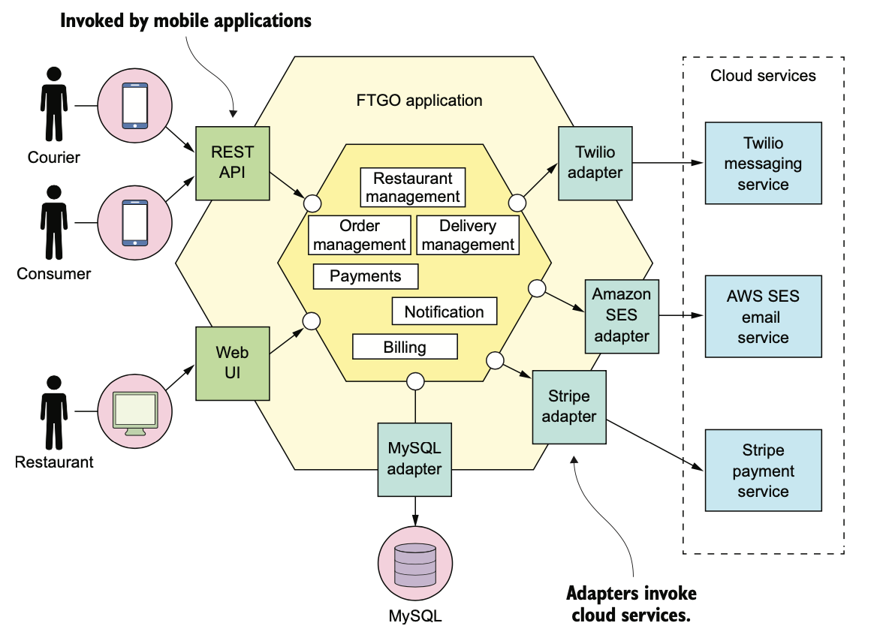
Software Design

Slide 3
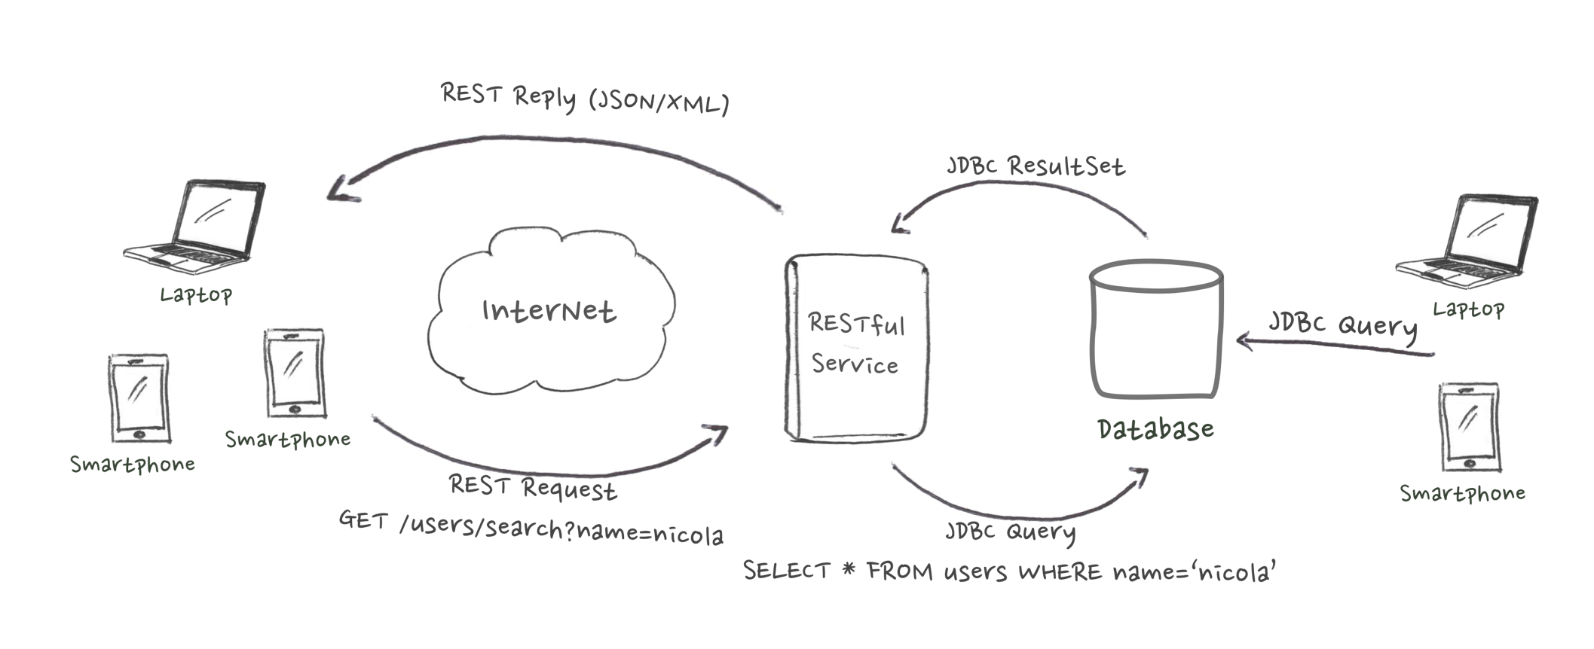
Why Learn REST?
REST is used to build scalable Web services (stateless is lightweight)
REST decouples applications from vendor-specific details (e.g., JDBC requires drivers and knowledge about the underlying database) and prevents exposing DMBS to untrusted networks (e.g. Internet)
Widely available libraries for many languages (e.g., RESTLet for Java)
Examples: https://github.com/toddmotto/public-apis

Slide 4
Why Learn REST?
(HTTP Request)
$ curl https://financialmodelingprep.com/api/v3/quote/AAPL
(JSON Reply)
[ {
"symbol" : "AAPL",
"name" : "Apple Inc.",
"price" : 276.10000000,
"changesPercentage" : 2.88000000,
"change" : 7.73000000,
"dayLow" : 272.22000000,
"dayHigh" : 277.85000000,
"sharesOutstanding" : 4375479808,
"timestamp" : 1587637985
} ]
(HTTP Request)
$ curl
https://financialmodelingprep.com/api/v3/company/profile/AAPL
(JSON Reply)
{
"symbol" : "AAPL",
"profile" : {
"companyName" : "Apple Inc.",
"exchange" : "Nasdaq Global Select",
"industry" : "Computer Hardware",
"website" : "http://www.apple.com",
"ceo" : "Timothy D. Cook",
"sector" : "Technology",
}
}

Slide 5
Why Learn REST?
A number of mobile apps are built upon RESTful services.
https://www.instagram.com/developer/
https://developer.twitter.com/en/docs
https://developers.facebook.com/docs/graph-api
https://www.flickr.com/services/api/
https://developer.foursquare.com/

Slide 6
Major Concepts
Messages
Resources (URIs)
Representations
Operations
Statelessness

Slide 7
Messages
Clients and REST services talk to each other via messages. Clients send a HTTP request to the server, and the server replies with a HTTP response.
Request and response contain both metadata and content
Response content is usually represented in XML or JSON

Slide 8
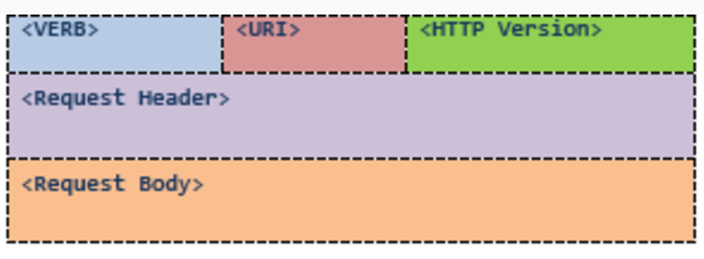
HTTP/1.1 Request

Slide 9
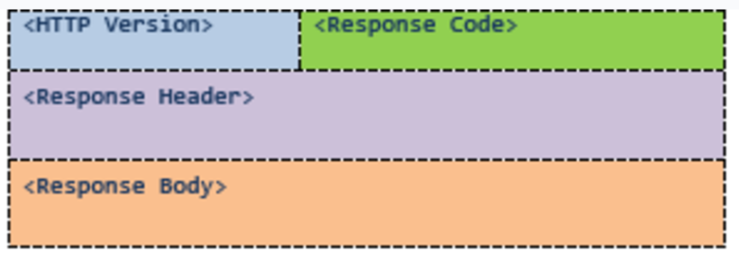
HTTP/1.1 Response

Slide 10
Resources
Every system uses resources. Resources can be pictures, videos, users data ecc...
The purpose of a service is to provide access to resources.
Developers want services to be easy to implement, maintain, extend, and eventually scale up.

Slide 11
Resources
Resources are identified with specific URLs
Format: https://servicename/apiversion/resource/id|service
For example:
Place details https://api.foursquare.com/v2/venues/VENUE_ID
Photos details https://api.foursquare.com/v2/photos/PHOTO_ID
Search for a user https://api.foursquare.com/v2/users/search
Recent checkins by friends https://api.foursquare.com/v2/checkins/recent

Slide 12
Representations
The focus of a RESTful service is on resources and how to provide access to these resources.
A resource can be thought of as an object as in OOP. A resource can consist of other resources.
While designing a system, the first thing to do is identify the resources and determine how they are related to each other.
This is similar to designing a database or object-oriented software: identify key entities and their mutual relations.

Slide 13
Representations
Once resources have been identified, it is important to properly represent resources (for example, the toString() method represent resources using a plain String).
You can use any format for representing the resources as REST does not put any restrictions.
Nevertheless, the most used representations are XML and JSON

Slide 14
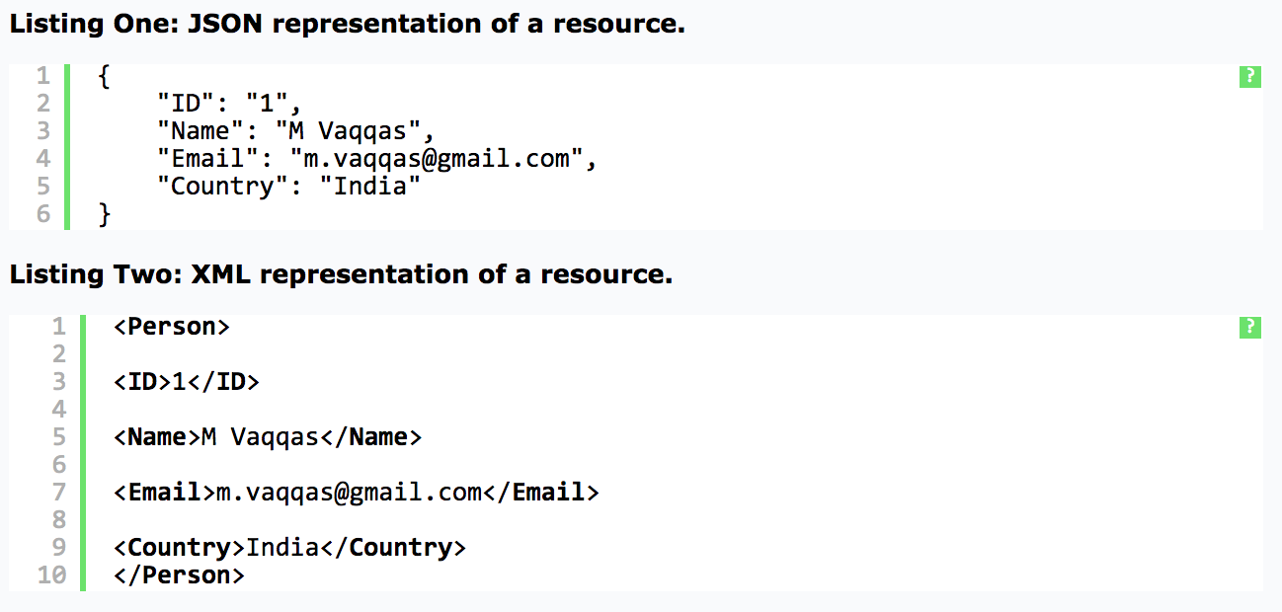
Representations

Slide 15
Operations (HTTP Verbs)
HTTP Verbs (see HTTP Request) define operations on specific resources.
GET /users/145 (retrieve user 145)
DELETE /users/145 (delete user 145)
POST /users/ (add a new user)
PUT /users/17 (update user 17)

Slide 16
Operations (HTTP Verbs)
GET Read a resource
Safe
PUT Insert/update a resource
Idempotent
POST Insert/update a resource
N/A
DELETE Delete a resource
Idempotent
A Safe HTTP method does not make any changes to the resource on the server.
An Idempotent HTTP method has same effect no matter how many times it is performed.
Classifying methods as Safe and Idempotent makes it easy to predict the results in unreliable environments such as the Web (clients may fire the same request multiple times for example)

Slide 17
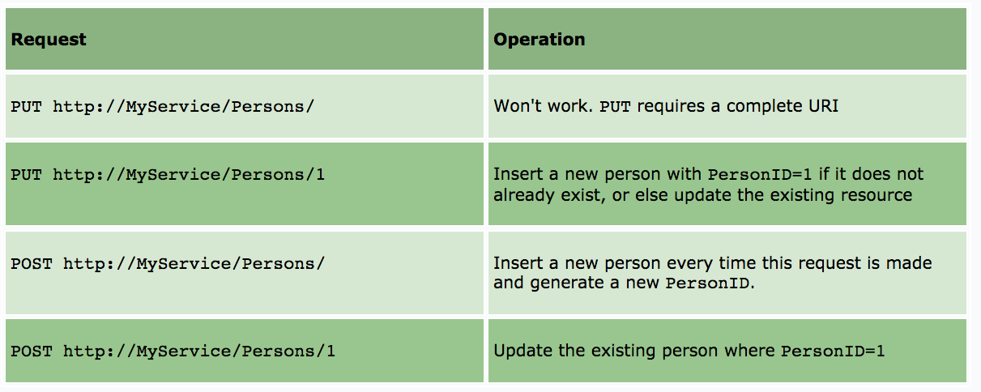
PUT and POST
Idempotent fails here!

Slide 18
Addressing resources (URIs)
REST requires each resource to have at least one URI
RESTful services uses a directory hierarchy to address resources
The job of a URI is to identify a resource or a collection of resources
The actual operation is determined by an HTTP verb. The URI should not say anything about the operation or action
Protocol://ServiceName/ResourceType/ResourceID

Slide 19
Addressing resources (URIs)
Use plural nouns for naming your resources.
Avoid using spaces as they create confusion. Use an _ (underscore) or – (hyphen) instead.
A URI is case insensitive. I use camel case in my URIs for better clarity. You can use all lower-case URIs.
A cool URI never changes; so give some thought before deciding on the URIs for your service. If you need to change the location of a resource, do not discard the old URI and redirect the client to the new location.
Avoid verbs for your resource names. Verbs are more suitable for the names of operations.

Slide 20
Query parameters
The basic purpose of query parameters is to provide parameters to an operation that needs the data items.
http://MyService/Persons/1?format=json
http://MyService/Persons/search?name=‘nicola’
Avoid this!
http://MyService/Persons/1/json/

Slide 21
Statelessness
A RESTful service is stateless and does not maintain the application state for any client. A request cannot be dependent on a past request. A REST service treats each request independently.
Stateless design
Request1: GET http://MyService/Persons/1 HTTP/1.1
Request2: GET http://MyService/Persons/2 HTTP/1.1
Stateful design (Dangerous! Which client??)
Request1: GET http://MyService/Persons/1 HTTP/1.1
Request2: GET http://MyService/NextPerson HTTP/1.1

Slide 22
Documentation
There is no excuse for not documenting your service.
You should document every resource and URI for client developers. You can use any format for structuring your document, but it should contain enough information about resources, URIs, Available Methods, and any other information required for accessing your service.

Slide 23
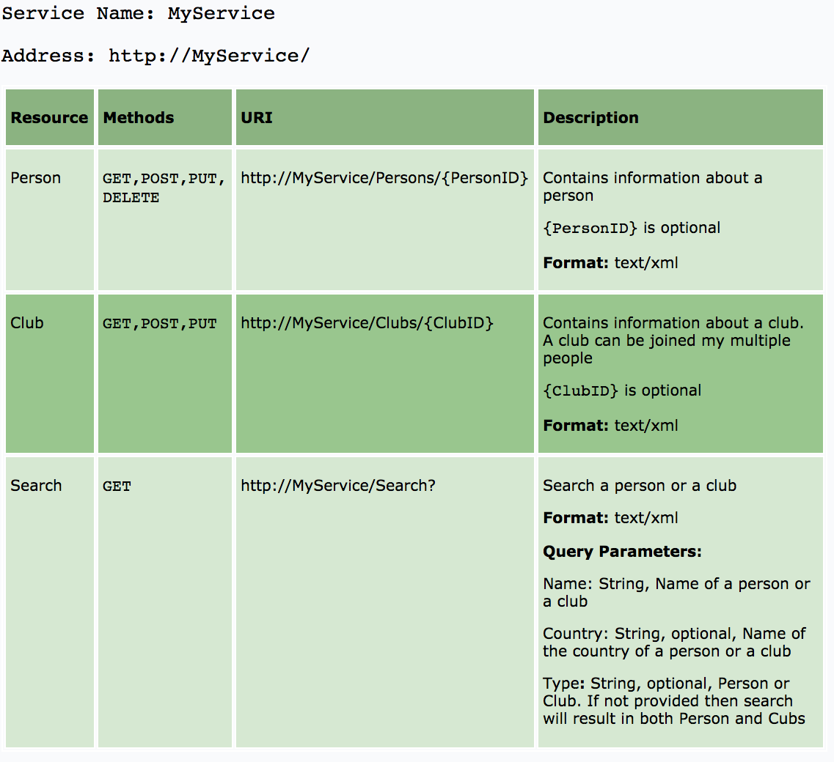
Documentation

Slide 24
Criticism
No transactions support
DBMS (usually behind REST services) support transactions
No publish/subscribe support.
Notification is done by polling.
High bandwidth
HTTP uses a request/response model, so there’s a lot of baggage flying around the network to make it all work.

Slide 25
Advantages
REST is a great way of developing lightweight Web services that are easy to implement, maintain, and discover.
HTTP provides an excellent interface to implement RESTful services with features like a uniform interface and caching. However, it is up to developers to implement and utilize these features correctly.
If we get the basics right, a RESTful service can be easily implemented using any of the existing technologies such as Python, .NET, or Java.

Slide 26
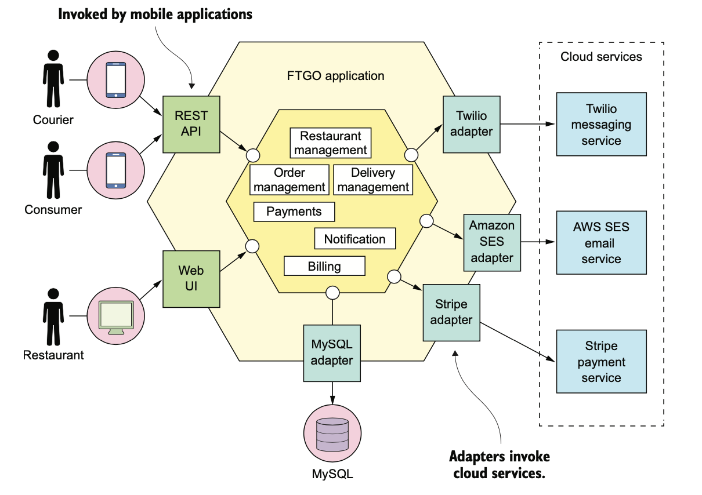
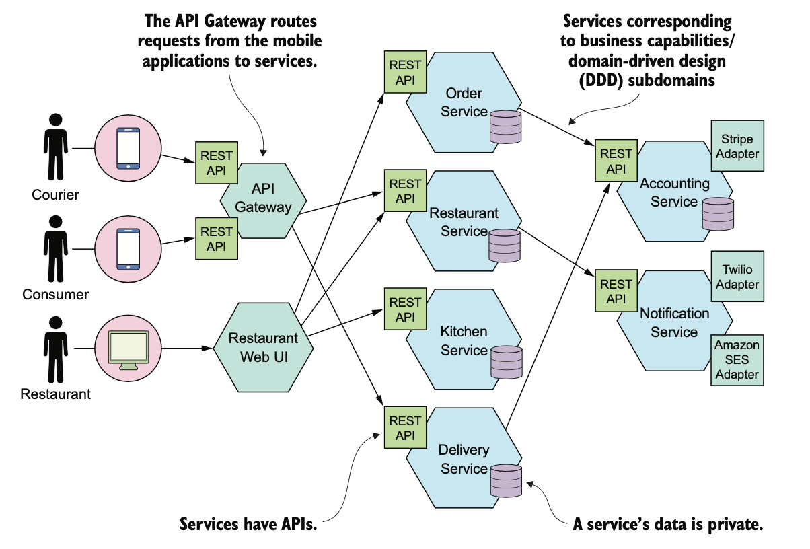
Advantages

